Slide 1

DAA Lecture # 1
Engr. Naveera Sami

Slide 2
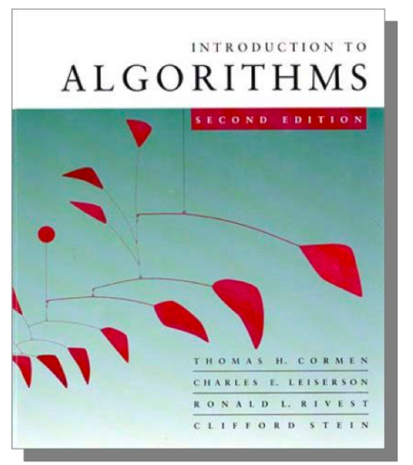
Books:
Textbook
Introduction to Algorithms 2nd ,Cormen,
Leiserson, Rivest and Stein, The MIT Press, 2001.
Data Structures and Algorithm Analysis
Clifford A. Shaffer,Edition 3.2 (C++ Version),2012.
Others
Introduction to Design & Analysis Computer Algorithm 3rd, Sara Baase, Allen Van Gelder, Adison-Wesley, 2000.
Algorithms, Richard Johnsonbaugh, Marcus Schaefer, Prentice Hall, 2004.
Introduction to The Design and Analysis of Algorithms 2nd Edition, Anany Levitin, Adison-Wesley, 2007.

Slide 3
Course Objectives:
This course introduces students to the analysis and design of computer algorithms. Upon completion of this course, students will be able to do the following:
Analyze the asymptotic performance of algorithms.
Demonstrate a familiarity with major algorithms and data structures.
Apply important algorithmic design paradigms and methods of analysis.
Synthesize efficient algorithms in common engineering design situations.

Slide 4
Topics Involved:
In this course we will cover the following topics:
Understand foundations of algorithms && design and analysis various variants algorithms
Accuracy
Efficiency
Comparing efficiencies
Make use of skills to understand mathematical notations in algorithms and their simple mathematical proofs
Gain familiarity with a number of classical problems that occur frequently in real-world applications

Slide 5
Course Outline:
Preliminaries : different types of algorithms, analyzing methodologies, notations, proof techniques and limits.
Asymptotic Notation : different notations and their examples, standard notations and their common functions.
Analysis of Algorithms : analyzing control structures, using barometer
instruction, amortization, and different examples for analysis and solving recurrences.
Structures: use of arrays, stacks, queues, records, pointers, lists, graphs, trees, hash tables, heaps and binomial heaps.
Searching/Sorting Algorithms : Various searching and sorting algorithms and their comparisons.

Slide 6
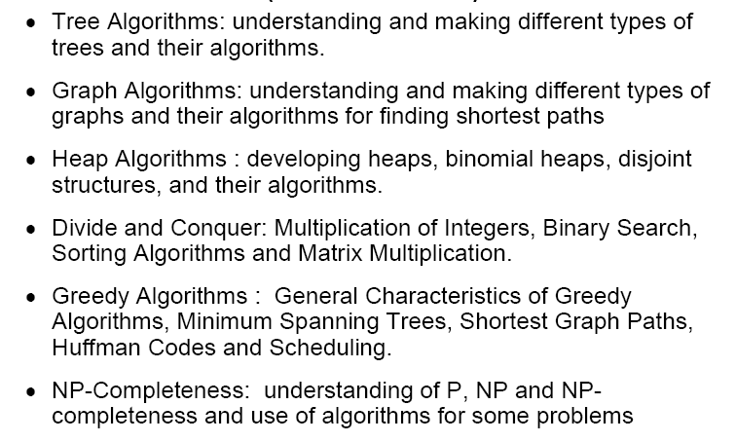
Course Outline:

Slide 7
Algorithm:
is any well-defined computational procedure that takes some value, or set of values, as input and produces some value, or set of values, as output.
is thus a sequence of computational steps that transform the input into the output.
is a tool for solving a well - specified computational problem.
Any special method of solving a certain kind of problem (Webster Dictionary)

Slide 8
What is the specification of algorithm?
We can specify an algorithm by 3 types:
1. Using Natural language
2. Pseudocode;
3. And flowchart.
Natural language is general way to solve any problem
For e.g to perform addition of two numbers we write in natural language
Step1: read the first number (assume a)
Step2:read the second number (assume b)
Step3:add 2 numbers(a and b)and store the result in a variable c
Step4:display the result specification of algorithm?

Slide 9
Pseudocode
Combination of natural language and programming language construct For e.g.to perform addition of two numbers we write in pseudo-code
//this algo perform addition of two integers
//input two integers a and b
// output of two integers
C=a+b
Write c

Slide 10
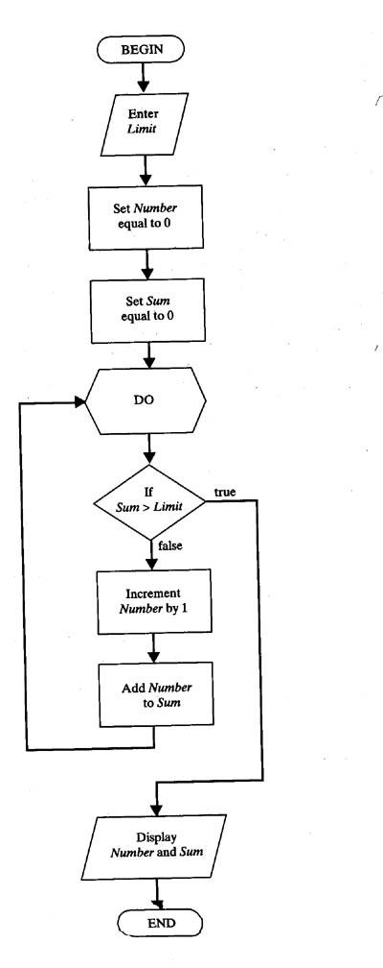
Another way to represent an algo is Flow chart

Slide 11

ALGORITHMICS
It is the science that lets designers study
and evaluate the effect of algorithms
based on various factors so that the best
algorithm is selected to meet a particular
task in given circumstances. It is also the
science that tells how to design a new
algorithm for a particular job.

Slide 12
What is a program?
A program is the expression of an algorithm in a programming language
a set of instructions which the computer will follow to solve a problem

Slide 13
Analysis of an Algorithm
What is analysis of an algorithm?
Ans. Algorithm analysis is an important part of a computational complexity theory.
There two types of analysis:
1.priori
2.posteriory

Slide 14
Analysis of an Algorithm
Priori Analysis is the theoretical estimation of resources required.
On the other hand posterior Analysis done after implement the algorithm on a target machine.

Slide 15
Introduction
Why need algorithm analysis ?
writing a working program is not good enough
The program may be inefficient!
If the program is run on a large data set, then the running time becomes an issue

Slide 16
Complexity of an algorithm
What is the complexity of an algorithm?
Complexity (or efficiency) of an algorithm is a function that describes the efficiency of an algorithm in terms of time and space.
There are two types of complexity:
1.Time complexity:
Time complexity means the amount of time required by an algorithm to run.
It expressed as an order of magnitude / degree

Slide 17
Space Complexity
Space complexity means the amount of space required by an algorithm to run.It expressed as an order of magnitude.There are two important factors to compute the space complexity:constant and instant characterstic.
e.g
factorial(n)
if n=0 then
return 1;
else
return*factorial(n-1);
endif
space complexity of program = constant size + variable size

Slide 18
Types of Algorithms

Slide 19
PROBABILISITIC ALGORITHM
In this algorithm, chosen values are used
in such a way that the probability of chosen each value is known and controlled.
e.g. Randomize Quick Sort

Slide 20
HEURISTIC ALGORITHM
This type of algorithm is based largely on optimism and often with minimal theoretical support. Here error can not be controlled but may be estimated how large it is.
Notes:
Heuristic meaning : encouraging a person to learn, discover, understand, or solve problems on his or her own, as by experimenting, evaluating possible answers or solutions, or by trial and error: a heuristic teaching method.

Slide 21
APPROXIMATE ALGORITHM
In this algorithm, answer is obtained that is as précised as required in decimal notation. In other words it specifies the error we are willing to accept.
For example, two figures accuracy or 8 figures or whatever is required.

Slide 22
Things to do……
Learn general approaches to algorithm design
Divide and conquer
Greedy method
Dynamic Programming
Basic Search and Traversal Technique
Graph Theory
Linear Programming
Approximation Algorithm
NP Problem

Slide 23
Some Application
Study problems these techniques can be applied to
sorting
data retrieval
network routing
Games
etc

Slide 24
What do we analyze about them?
Correctness
Does the input/output relation match algorithm requirement?
Amount of work done (aka complexity)
Basic operations to do task finite amount of time
Amount of space used
Memory used

Slide 25
Strengthening the Informal Definition
Important Features:
Finiteness.[algo should end in finite amount of steps]
Definiteness.[each instruction should be clear]
Input.[valid input clearly specified ]
Output.[single/multiple valid output]
Effectiveness.[ steps are sufficiently simple and basic]

Slide 26
performance analysis
What is performance analysis?
Performance analysis is the criteria for judging the algorithm.It have direct relationship to performance.When we solve a problem ,there may be more then one algorithm to solve a problem,through analysis we find the run time of an algorithms and we choose the best algorithm which takes lesser run time.

Slide 27
Example Of Algorithm

Slide 28
Few Classical Examples
Classical Multiplication Algorithms
English
American
A la russe
Divide and Conquer

Slide 29
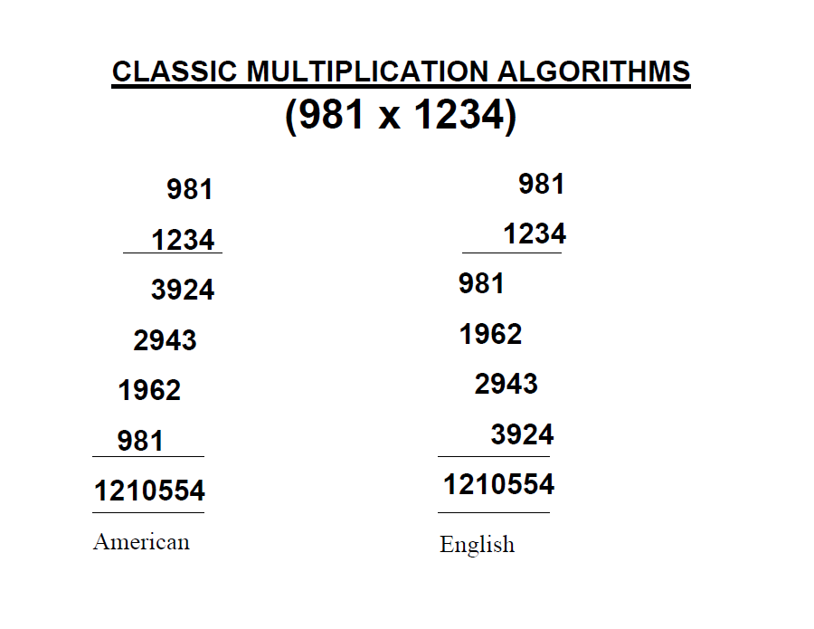
Classic Multiplication

Slide 30
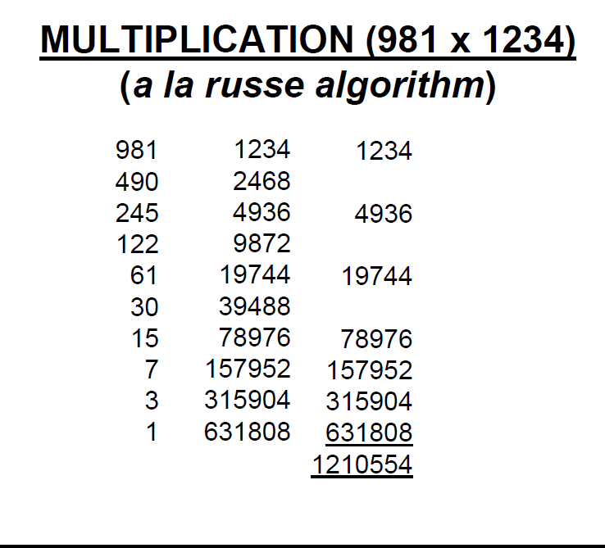
Multiplication

Slide 31
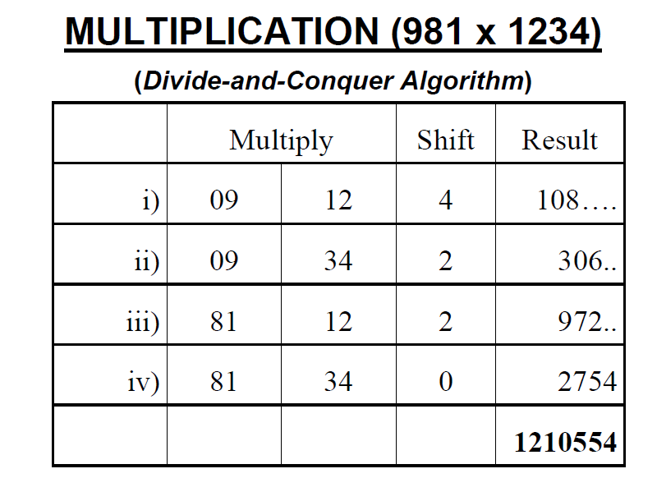
Multiplication

Slide 32
The Selection Problem
Which algorithm is better?

Slide 33
Which algorithm is better?
The algorithms are correct, but which is the best?
Measure the running time (number of operations needed).
Measure the amount of memory used.
Note that the running time of the algorithms increase as the size of the input increases.

Slide 34
Running Time
Most algorithms transform input objects into output objects.
The running time of an algorithm typically grows with the input size.
Average case time is often difficult to determine.
We focus on the worst case running time.
Easier to analyze
Crucial to applications such as games, finance and robotics

Slide 35
Experimental Studies
Write a program implementing the algorithm
Run the program with inputs of varying size and composition
Use a method like System.currentTimeMillis() to get an accurate measure of the actual running time
Plot the results

Slide 36
Limitations of Experiments
It is necessary to implement the algorithm, which may be difficult
Results may not be indicative of the running time on other inputs not included in the experiment.
In order to compare two algorithms, the same hardware and software environments must be used

Slide 37
Theoretical Analysis
Uses a high-level description of the algorithm instead of an implementation
Characterizes running time as a function of the input size, n.
Takes into account all possible inputs
Allows us to evaluate the speed of an algorithm independent of the hardware/software environment

Slide 38
RAM model
has one processor
executes one instruction at a time
each instruction takes "unit time“
has fixed-size operands, and
has fixed size storage (RAM and disk).

Slide 39
Counting Primitive Operations (§3.4)
By inspecting the pseudo code, we can determine the maximum number of primitive/basic operations executed by an algorithm, as a function of the input size
Algorithm arrayMax(A, n)
# operations
currentMax ← A[0] 2
for (i =1; i<n; i++) 2n
(i=1 once, i<n n times, i++ (n-1) times:post increment i.e 1+ n + n -1 = 2n )
if A[i] > currentMax then 2(n − 1)
currentMax ← A[i] 2(n − 1)
return currentMax 1
Total 6n −1
Notes:
i<n last condition checking n times
i++ n-1 last time terminate at 2nd part

Slide 40
Estimating Running Time
Algorithm arrayMax executes 6n − 1 primitive operations in the worst case.
Define:
a = Time taken by the fastest primitive operation
b = Time taken by the slowest primitive operation
Let T(n) be worst-case time of arrayMax. Then a (6n − 1) ≤ T(n) ≤ b(6n − 1 )
Hence, the running time T(n) is bounded by two linear functions

Slide 41
Growth Rate of Running Time
Changing the hardware/ software environment
Affects T(n) by a constant factor, but
Does not alter the growth rate of T(n)
The linear growth rate of the running time T(n) is an essential property of algorithm arrayMax

Slide 42
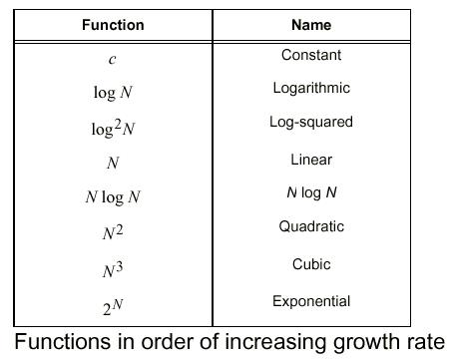
Function of Growth rate

Slide 43
Big-Oh Notation
To simplify the running time estimation,
for a function f(n), we ignore the constants and lower order terms.
Example: 10n³+4n²-4n+5 is O(n³).

Slide 44
Why ???
Why we are measuring the complexity of Algorithms ???.
Reason : Not only to design algorithms but to design efficient type of algorithms which can finish in finite amount of time.

Slide 45
Why asymptotic Notations
Asymptotic notation is a way to represent the time complexity
Design efficient algorithm terminate in finite amount of Time/ acceptable amount of time.
Making use of Asymptotic notations for measuring running time of algorithm for large input size and measure its growth rate .

Slide 46
Input Size
Input size (number of elements in the input)
size of an array
polynomial degree
# of elements in a matrix
# of bits in the binary representation of the input
vertices and edges in a graph

Slide 47
Efficiency Measurement
Efficiency relative term
Single algorithm : Polynomial Time Period
(Efficient)
Comparing Algorithms for finding their efficiencies
Notes:
In a polynomial function, the variable x is raised to some integer power. f(x) = 5x³ + 8x⁵ g(x) = (x + 5)² In an exponential function, some real number is raised to the power of variable x or some function of x f(x) = 5ˣ g(x) = eˣ⁺²

Slide 48
Types of Analysis
Worst case (at most BIG O)
Provides an upper bound on running time
An absolute guarantee that the algorithm would not run longer, no matter what the inputs are
Best case (at least Omega Ω )
Provides a lower bound on running time
Input is the one for which the algorithm runs the fastest
Average case (Theta Θ )
Provides a prediction about the running time
Assumes that the input is random

Slide 49
How do we compare algorithms?
We need to define a number of objective measures.
(1) Compare execution times?
Not good: times are specific to a particular computer !!
(2) Count the number of statements executed?
Not good: number of statements vary with the
programming language as well as the style of the individual programmer.

Slide 50

Thanks

